Slide 1

welcome to ourclass
Phu Dong Primary School

Slide 2


Wednesday, October 17th 2018
Warm - up
GUESSING GAME

Slide 3

Cook

Slide 4
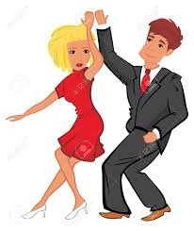

Dance

Slide 5

Swim

Slide 6
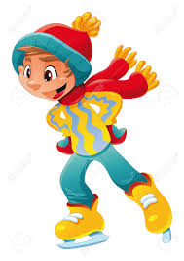
Skate

Slide 7

Sing

Slide 8
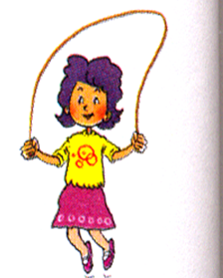
Skip

Slide 9
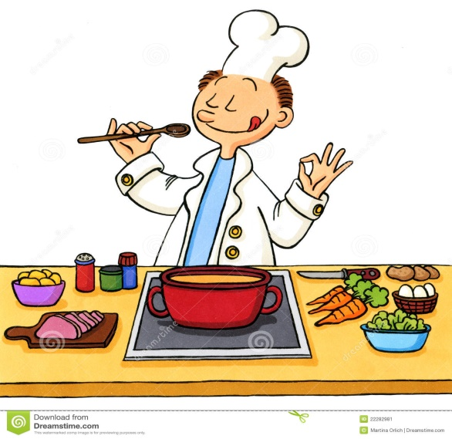


Cook
Dance
Swim
Skate
Sing
Skip

Slide 10

Unit 5: Can you swim?
Lesson 3

Slide 11
Unit 5: Can you swim?
Lesson 3
1. Listen and repeat.

Slide 12
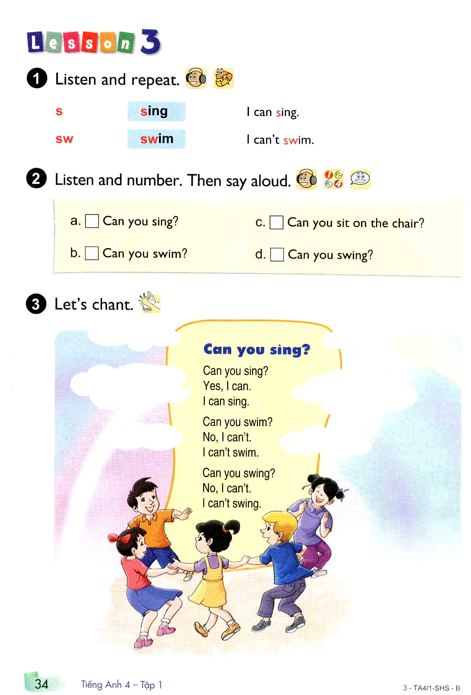


Slide 13
Unit 5: Can you swim?
Lesson 3
1. Listen and repeat.
2. Listen and number. Then say aloud.

Slide 14
4
2
1
3

Slide 15
Unit 5: Can you swim?
Lesson 3
1. Listen and repeat.
2. Listen and number. Then say aloud.
3. Let’s chant

Slide 17
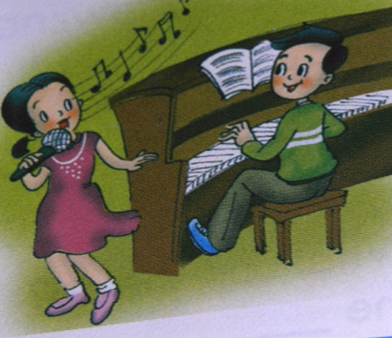
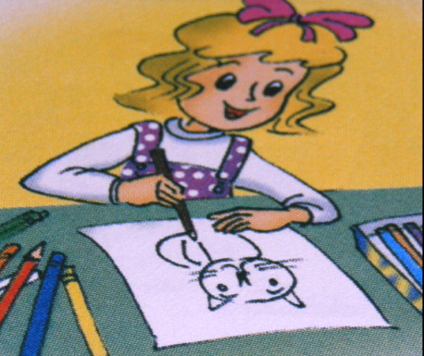

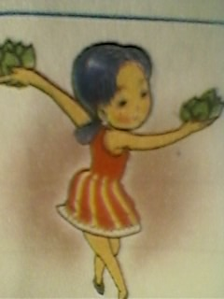
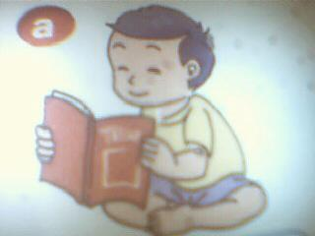
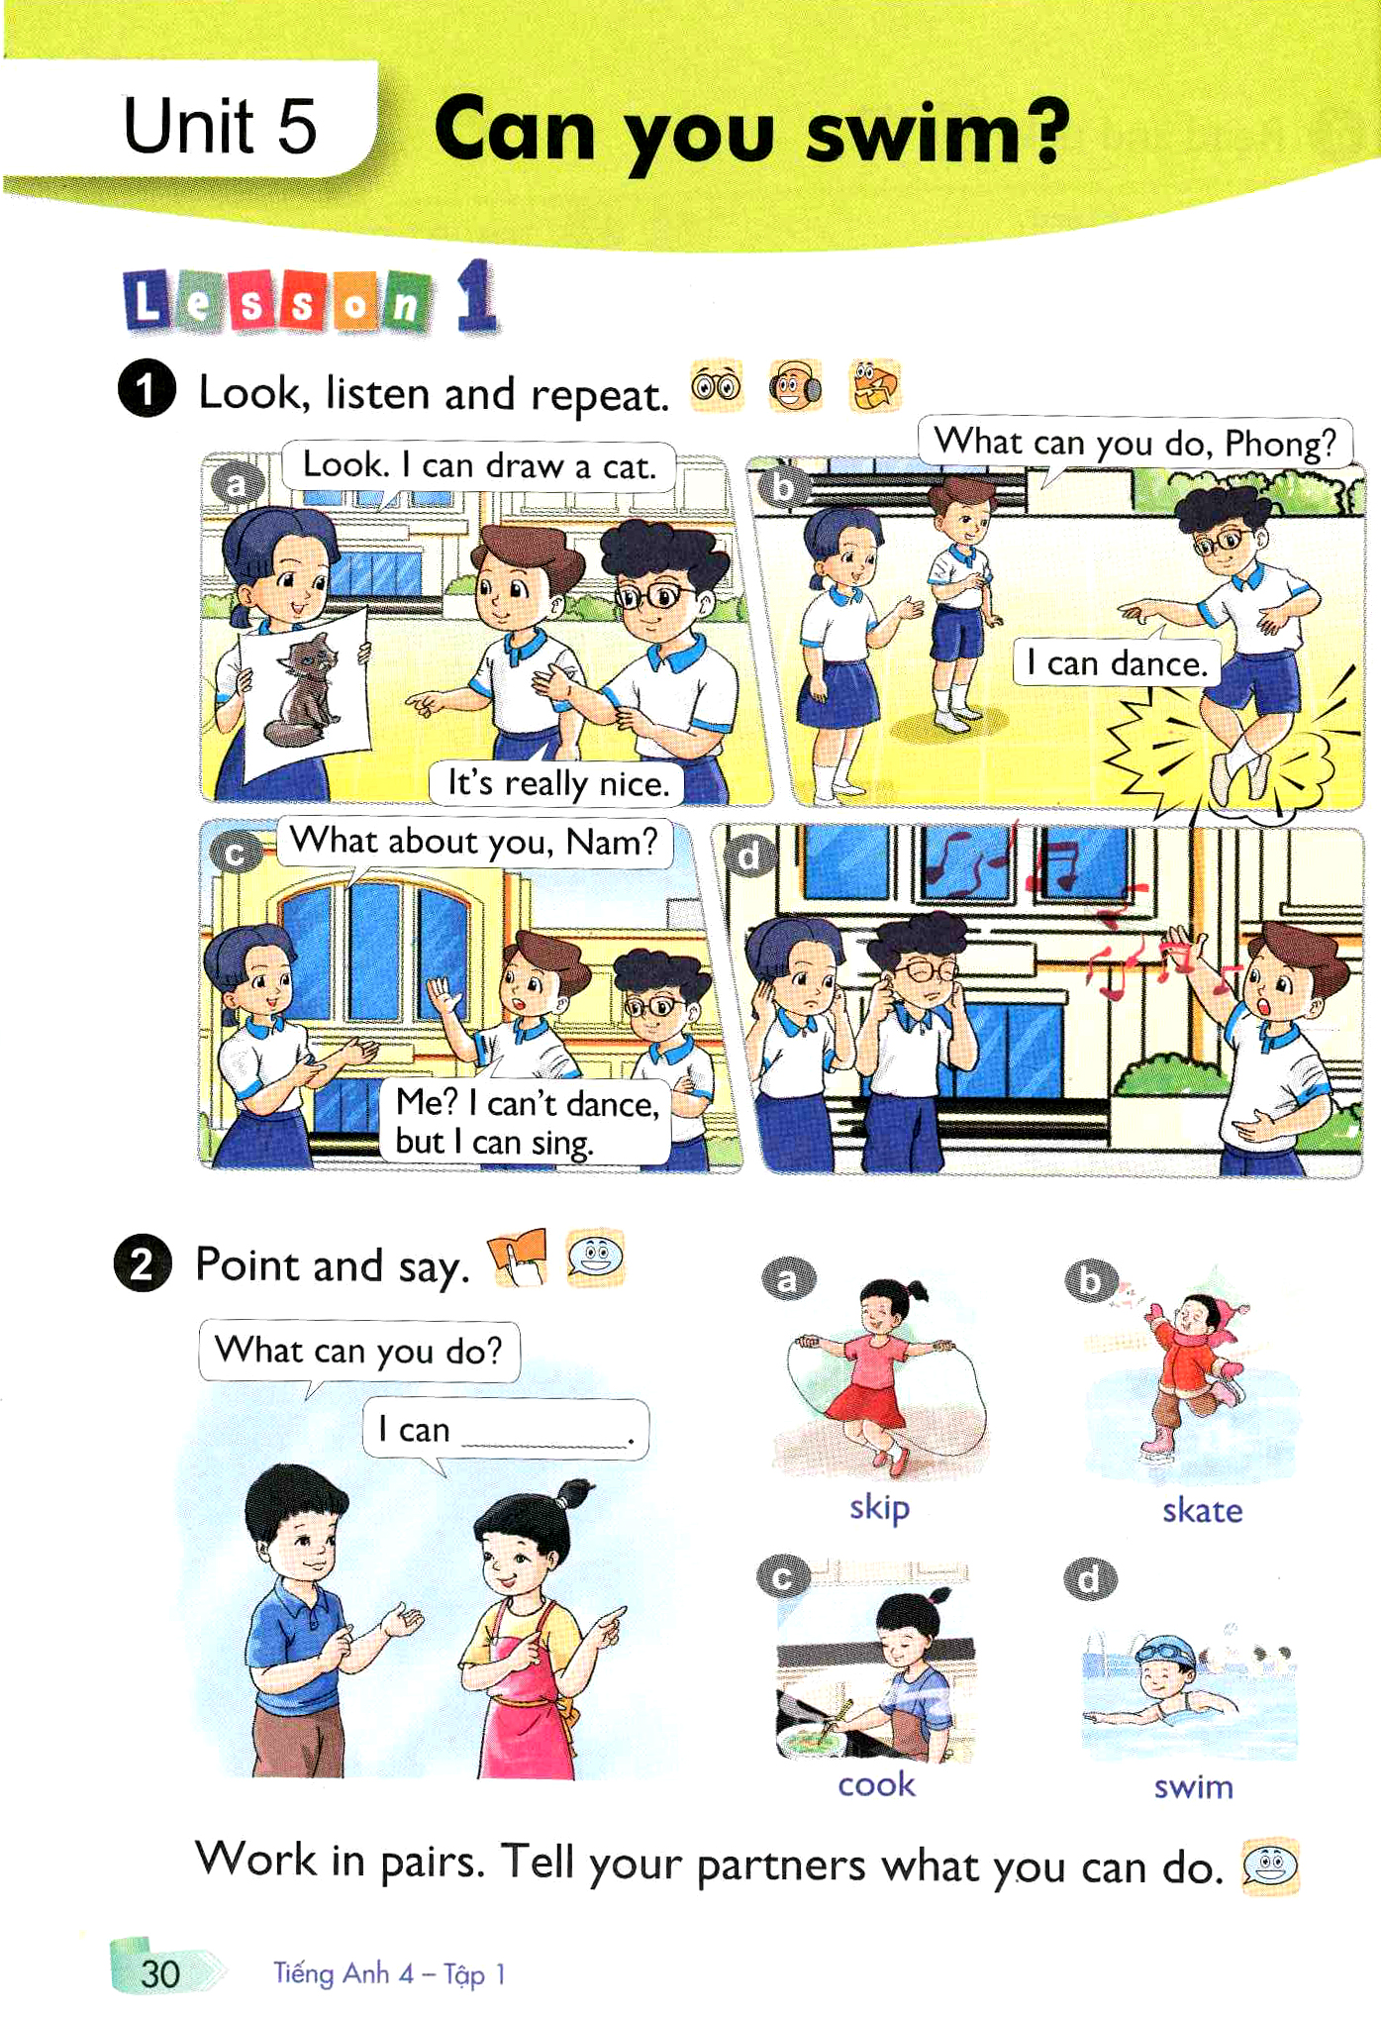
MATCHING
READ
DANCE
DRAW
COOK
SING
SWIM

Slide 18
Unit 5: Can you swim?
Lesson 3
1. Pronunciation
s sing I can sing.
sw swim I can’t swim.
2. Model sentence:
Can you………….?
3. Let’s chant
Can you sing?

Slide 19



Practise with your friends.
Can you….?
Yes, I can.
No, I can’t.
I can…
- Learn by heart.
- Prepare Unit: 5 Lesson 3: (Part 4, 5, 6)

Slide 20


Thank you very much
Good bye! See you again!

